Slide 1
Swiggy’s Restaurant Recommendation System using Streamlit
Naveenkumar Sivakumar

Slide 2
Problem Statement:
Objective: To develop a high-performance recommendation engine that transforms raw restaurant data into personalized dining suggestions.
Core Purpose: Bridging the gap between food enthusiasts and the best local eateries through data-driven insights.

Slide 3
Interactive User Preferences
Localized Discovery: Users can filter through a vast database by selecting specific cities across India.
Cuisine Customization: Tailors recommendations based on specific flavor profiles, from traditional sweets to international fast food.
Budget Management: Features a specialized cost-filter focused on value-for-money options, strictly capped at ₹2,000.
Quality Assurance: Allows users to set a minimum star-rating threshold to ensure premium dining experiences.

Slide 4
Advanced Recommendation Engine
Intelligent Filtering: Processes thousands of entries in real-time to match user-specific constraints.
Optimized Sorting: Employs a dual-priority algorithm that ranks restaurants first by their rating quality and then by price efficiency.
Data Preprocessing: Handles complex data cleaning, including currency symbol removal and normalization of non-numeric rating values (e.g., "Too Few Ratings")

Slide 5
The Streamlit Interface (Output)
Top Pick Spotlight: Automatically identifies and highlights the #1 recommended restaurant with a dedicated "Top Pick" card.
Market Comparison: Provides live metrics comparing the selected restaurant's average cost and rating against the overall city market.
Interactive Visuals: Includes scatter plots and density charts to visualize the distribution of prices versus ratings.
Data Transparency: Features a searchable comparison table for a side-by-side look at all matching restaurant addresses and details.

Slide 6
Key Technical Features
Scalability: Built to handle datasets with over 140,000 unique records efficiently.
User-Centric Design: A clean sidebar navigation for an intuitive and responsive user experience.
Visual Analytics: Leverages Matplotlib and Seaborn to provide professional-grade market analysis directly within the dashboard.

Slide 7
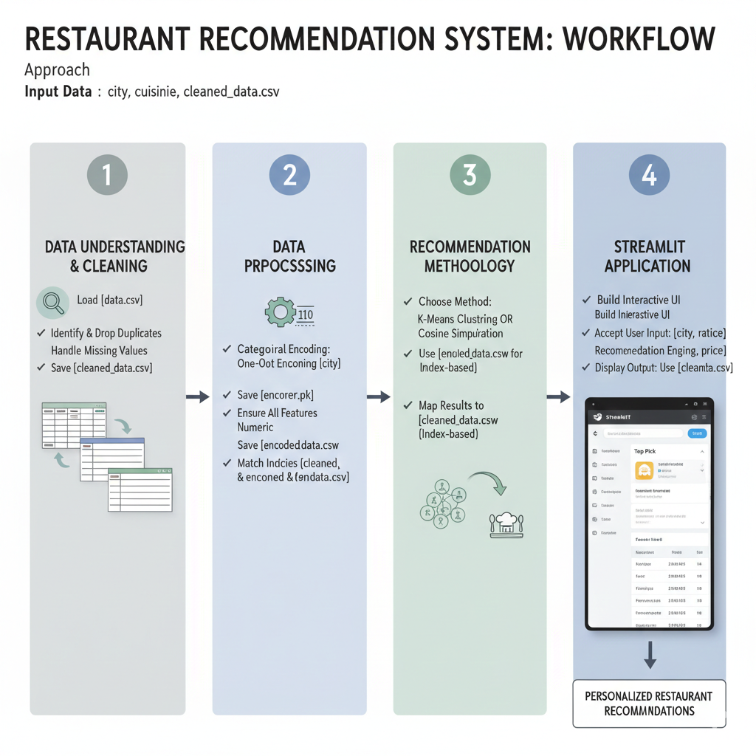

Slide 8
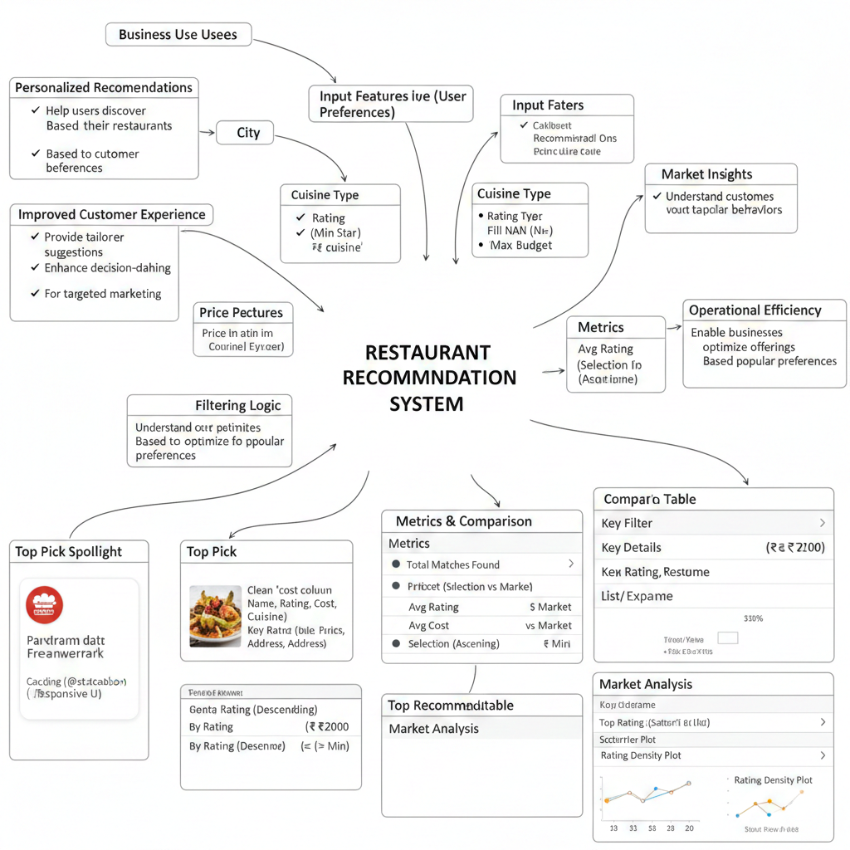

Slide 9


